Slide 1
Chapter 6: S. D. as ruler, Normal Model (Last chapter of this unit)
AP Statistics

Slide 2
Standard Deviation
Useful for comparing different-looking values
Performance in target shooting (accuracy)
Performance in running (time)
For each metric, how does data vary from mean?
Standard deviation = Ruler

Slide 3
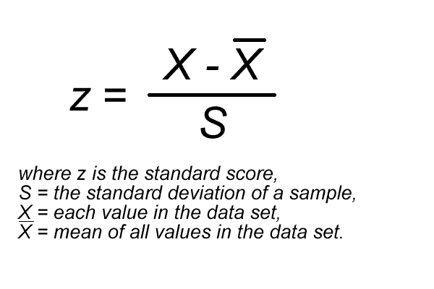
Z-score
Standardized Value
No units (units divide away)
Use “center” and “spread” in reading this equation to your neighbor.

Slide 4
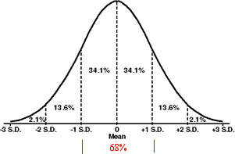
Example with z
z = 2 means datum is 2 S.D. above the mean
z = -2 means ?
z > 1 means ?
Higher |z| = more different
from mean,
more unusual,
less Probability

Slide 5
Example re. finding & applying z
In class A, your 2 lowest tests will be dropped. Tests are “curved,” meaning they are standardized. Your scores:
Test 1: 90 with class mean 88, S.D. 4
Test 2: 80 with class mean 75, S.D. 5
Which one is dropped?
Calculate z for each to answer the question.

Slide 6
Transforming Data
“All models are wrong, but some are useful.”
George Box (Statistician)

Slide 7
Statistics Changing with Transformations
Shifting (+ or – by constant)
Shift by constant: , min, max, median, quartiles
Unchanged: Range, IQR, s
Rescaling (x or by constant)
Rescale by constant: , min, max, median, quartiles
Change proportionally: Range, IQR, s
Standardizing = Shift by AND Rescale by s
becomes zero
S becomes 1
No change in distribution shape

Slide 8
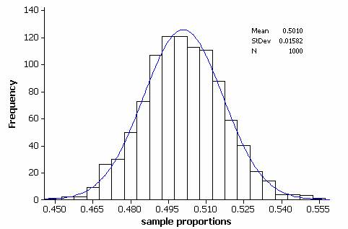
Normal Model
“bell shaped curve”
For unimodal, symmetric dist.s ONLY
Models don’t use data summaries G( , s)
Models use model parameters N( , )

Slide 9
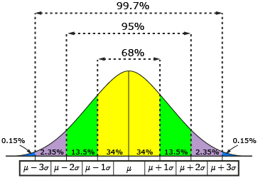
Standard Normal Model
N( , ) = N (0, 1)
Has a “standard normal distribution”
68% values w/1 1
95% w/in 2
99.7 w/in 3
What % is above 1 ?
Nearly Normal Condition: Distrib. is unimodal and symmetric (so assume it is normal)

Slide 10
Table of Normal Percentiles
When values aren’t an integer multiple of
Convert to Standard Normal first
Use mean 0, std dev 1
Find z
Use Table z (Appendix A-78, A-79) or calculator
x 100 value in cell (% of pop (area under curve) less than your z score)
Find the z score for the 20% percentile.
What area is less than z score = 2.5?

Slide 11
Normalcdf and InvNorm
2nd DISTR
normalpdf(x) – find y for a Normal curve
normalcdf(zleft, zright) – find area between 2 z scores
invNorm(%ile) – find z score for specific area starting from left
Try it on your calculator:
a) What area is between z scores 1 and -1? (You should already know this answer)
b) What area is above z = 1.8? (Use 2nd z of 99 as you cannot enter infinity)
c) What is the z-score at the 30% percentile?

Slide 12
Normal probability plot
x: Normal scores (z scores)
y: quantitative unit (e.g. weight)
Diagonal line IF Normal dist.
Not straight diagonal line? Normal model not reliable here.

Slide 13
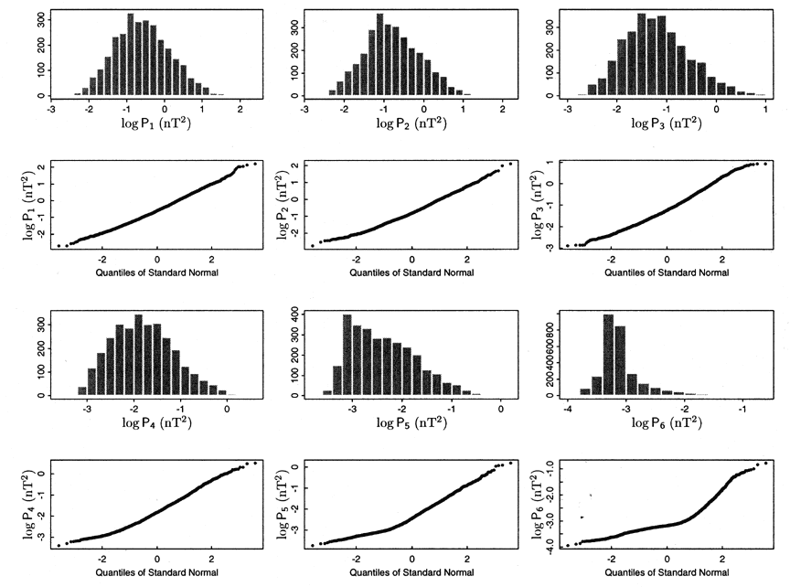
Normal or Not Normal?

Slide 14
Normal Prob Plot on Calculator
Data (enter as list)
22 17 18 29 22 23 24 23 17 21
STATPLOT On
Type: pick last one
Data Axis: Y
ZoomStat
What can be concluded?

