Slide 1
Chapter 5: Describing Quant. Distrib.s with Numbers
AP Stats
Notes:
\\mvhsfs4\Math\Media\Against All Odds-inside Statistics

Slide 2
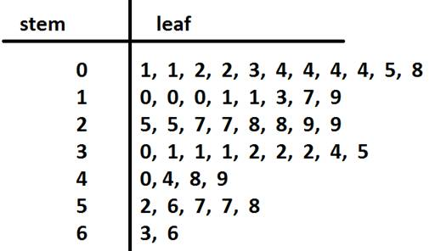
Center
Mode
Midrange = (min + max)/2
Median = 50% percentile
Best center for skewed data
Odd # of pts? (n+1)/2
Even? Halfway between n/2 and (n/2) + 1
Mean: “mean of x”
Only appropriate for symmetric data
Ages at a birthday party, n=47
Try calculating mean on your calculator, after entering the data into a list. What other centers will your calculator report?

Slide 3
Spread
Range = max – min
Interquartile Range (IQR) = upper quartile – lower quartile
Upper quartile = 75th percentile = Q3 = median btwn median and max
Lower quartile = 25th percentile = Q1 = median btwn median and min
If odd n, include median in both halves to calc. quartiles (book’s convention)
Ages at a birthday party, n=47

Slide 4
5-number summary for Boxplot
Max
Q3
Median
Q1
Min
Sketch the boxplot – don’t worry about fences or outliers yet.

Slide 5
Fences and Outliers
Upper Fence = Q3 + 1.5 IQR
Lower Fence = Q1 – 1.5 IQR
Whiskers are drawn to Max and Min values within fences only. Outliers would be points outside fences.
Remember “outlier” means nothing about quality of data and does not allow you to discard it.
Redraw your boxplot, with fences. Outliers?

Slide 6
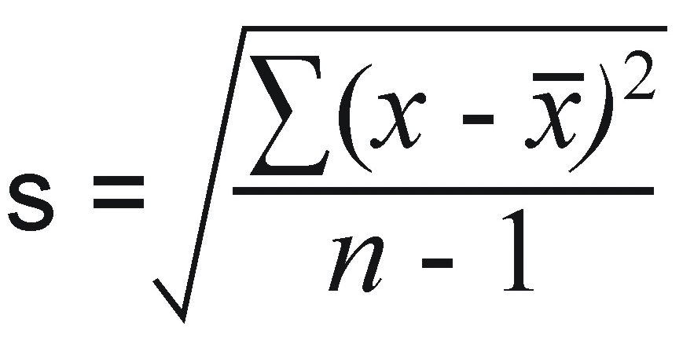
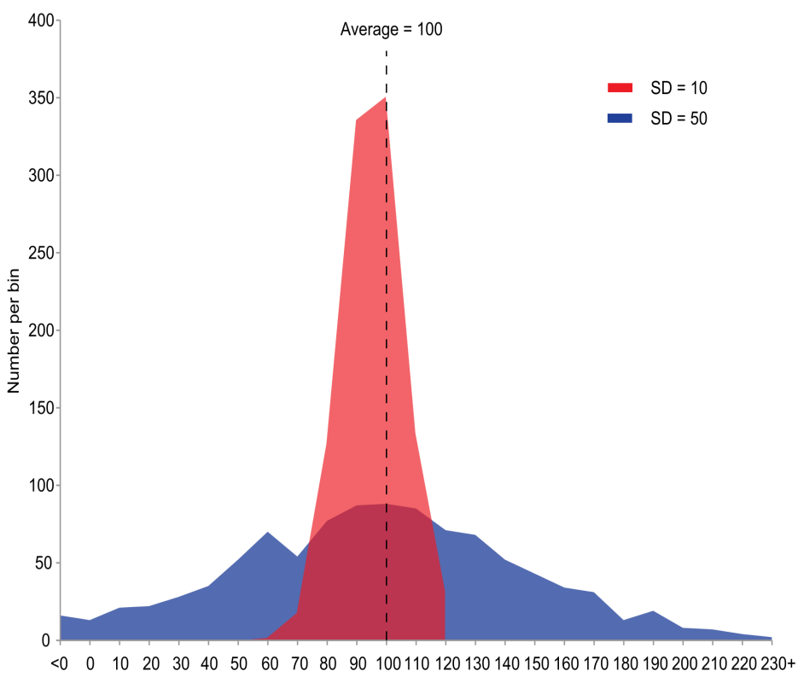
Spread: Standard Deviation
Use with symmetric data
Better than IQR as considers ALL data
What limited set of data does IQR use?
Difference from mean, squared, then “averaged”
Squaring difference → values above and below in symmetric distribution don’t cancel each other out
Notes:
If we were dividing by n only, then it would be a true average.

Slide 7
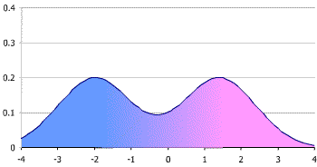
Handling Cases
Symmetric?
Report mean and std. dev.
Opt: ALSO median and IQR
Skew?
Report median and IQR
Outlier?
Report with AND without outlier
Median and IQR not likely impacted by outlier
Multimodal?
Consider dividing data into multiple groups

