Slide 1
Chapter 3: Displaying and Describing Categorical Data
AP Statistics
Review

Slide 2
Review: Categorical Data
Some examples of categories?
Categorical Data Condition: Categories cannot overlap …. If they did, this would lead to violaton of Sum to…

Slide 3
Distribution of Categorical Variables
Tables can have either or both:
Frequency (counts)
Relative Frequency (% or proportions)
Here AP Scores are treated as ordinal categorical (not quantitative).
AP Stats Exam Score | Frequency | Relative Frequency
5 | 25 | 40.3%
4 | 28 | 45.2%
3 | 7 | 11.3%
2 | 1 | 1.6%
1 | 1 | 1.6%

Slide 4
Clarity with presentation: %s

Slide 5
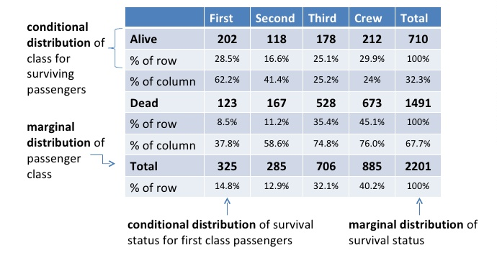
Contingency Table
Data is for two variables assumed to be contingent (aka contingent variables)
Is y contingent on x?
Conditional distribution; organized based on conditions
What is percent if x and y?
% of alive that are 1st class = 1st and alive/alive= 202/710
% of 1st class that are alive = _____________________________
Margins show frequency dist.s for each category (aka marginal distribution)
- Dist of classes = 14.8:12.9:32.1:40.2
Can write conditional dists for categories too
Dist of Alive:
___________________

Slide 6
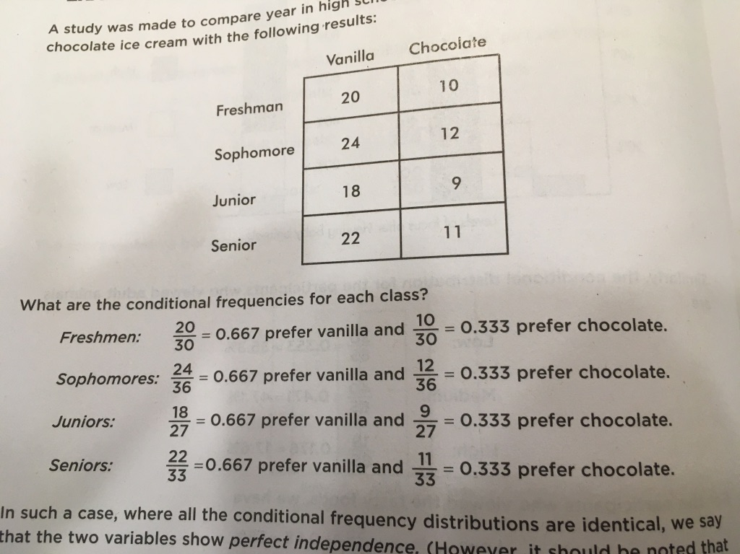
Thinking about H₀
“The best way to tell whether two variables are associated is to ask whether they are not.”
If dist. of one var. is same for all cat.s of another in contingency table, var.s are independent.
P(A|B) = P(A) → independence

Slide 7
Work the Table: Add margins to generate relative frequencies!

Slide 8
1) What percent of pictures viewed are of Tasty Foods? 2) What’s the distribution of pictures viewed? 3) What’s the conditional distribution of medium focus? 4) What percent of baby animal viewings is associated with high focus? 5) What percent of high focus events is associated with viewing baby animals? 6) Does it seem that level of focus is independent of pictures viewed?

Slide 9
Categorical Variables in Charts
Bar chart = frequency OR relative frequency [dot plots also possible]
Note: Always add spaces between bars to imply they can be in any order
Pie chart = relative frequency
AP Exam Score
Number of Students
Percentage of Students
AP Exam Score

Slide 10
Segmented Bar Chart
Relative frequency
Whole bar = 100%
Remember, no overlap of categories allowed!
What condition is that?

Slide 11
Be wary: extracting raw data from summary (proportions)

Slide 12
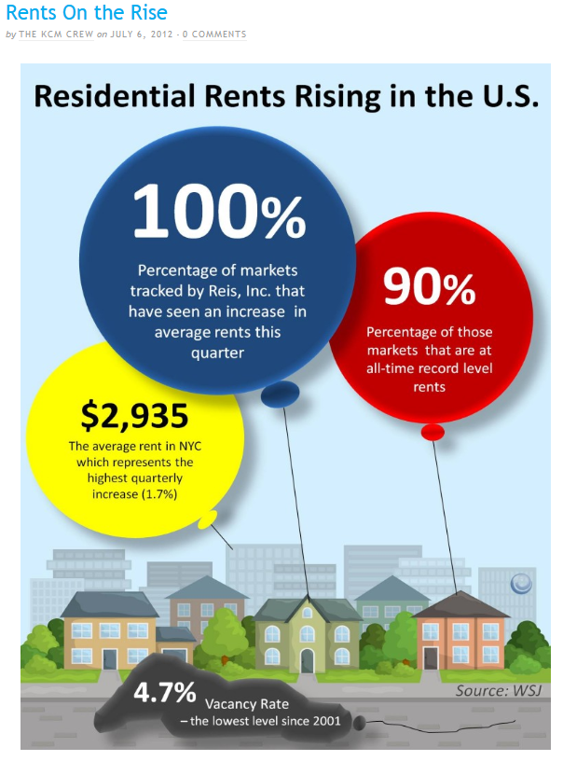
Area Principle
If your bar chart uses single graphics per bar
Area of a graph part SHOULD correspond to magnitude of value is represents

Slide 13
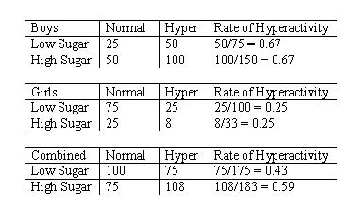
Is it appropriate? FACSS
Avoid “False Depth”
Category sizes/types should be equivalent
Y axis should range from zero to highest value
Area Principle
Categorical Data Condition
Sum to 100% (relative frequencies)
Avoid Simpson’s Paradox (“unfair averaging” for overall groups → diff. conclusion than comparing distinct groups)

Slide 14
What FACSS are violated?
Options:
False Depth
Area Principle
Categorical Data Condition
Sum to 100%
Simpson’s Paradox

Slide 15
What FACSS are violated?
 | Day | Night | Overall
Pilot Moe | 90 of 100 | 10 of 20 | 100 of 120
Pilot Jill | 19 of 20 | 75 of 100 | 94 of 120
Options:
False Depth
Area Principle
Categorical Data Condition
Sum to 100%
Simpson’s Paradox
 | Day | Night | Overall
Pilot Moe | 90% | 50% | 83%
Pilot Jill | 95% | 75% | 78%

Slide 16
Working with data should make me CUSS!
CUSS: Center-Unusual Features-Shape-Spread
When you have data, you should always GRAPH first.
Why does graphing NOT work well with categorical data? (Consider what parts of CUSS are not clear in graph.)

Slide 17
Q #1
Is survival dependent on the doctor operating on me? (use top graph)
Bottom two graphs show data when we look at the Condition the patient was in before operation. This Condition is what type of variable in the study? Does this change your decision about dependence or who is the better doctor?

Slide 18
Q #2
What percentage of NE folks prefer country music?
Which is the greatest count of people? (for instance, an answer might be Classical Music lovers in the South) CAREFUL!
All 3 bars have a height of 100%. What does this indicate?
Is there a relationship between geographic location and music preference?

Slide 19
Q #3
This is data from what kind of study?
What is the marginal distribution of political parties?
What is the conditional distribution for “Against”?
What percentage are democrats?
What percentage of the set were “For” and Republican?
What percentage of Independents had “No opinion”?
What percentage of those “Against” were Democrats?
Voters of which political party were most likely to have “No opinion”?

Slide 20
Q #4
What value n results in the table showing perfect independence?

Slide 21
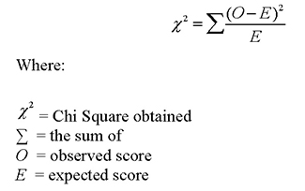
Q #5
Are top search topics independent of age of student?
Bonus: Chi-Squared Test of Independence:
Chi-squared = (22-36)^2/36 + …
Chi-Squared = ?
Critical value for df = 2 is 5.991 (alpha 5%)
A table: https://www.mun.ca/biology/scarr/4250_Chi-square_critical_values.html

