Slide 1
Chapter 3: Displaying and Describing Categorical Data
AP Statistics

Slide 2
With Statistics we…
Think
Use 5 Ws and H to organize data and its context
Predict
Identify Value or Significance
Show
Graph, calculate
Be wary of wrong model/calculation choice!
Tell
Conclude based on evidence
Be wary of misinterpretations!
Data Analysis

Slide 3
Review: Categorical Data
Some examples of categories?
Categorical Data Condition: Categories cannot overlap

Slide 4
Distribution of Categorical Variables
Tables can have either or both:
Frequency (counts)
Relative Frequency (% or proportions)
Here AP Scores are treated as ordinal categorical (not quantitative).
AP Stats Exam Score | Frequency | Relative Frequency
5 | 25 | 40.3%
4 | 28 | 45.2%
3 | 7 | 11.3%
2 | 1 | 1.6%
1 | 1 | 1.6%

Slide 5
Categorical Variables in Charts
Bar chart = frequency OR relative frequency
Note: Always add spaces between bars to imply they can be in any order
Pie chart = relative frequency
Note: for ALL frequency or rel frequ tables, no categories can overlap! (← C___________ D_____ Condition)
AP Exam Score
Number of Students
Percentage of Students
AP Exam Score

Slide 6
Segmented Bar Chart
Relative frequency
Whole bar = 100%
Remember, no overlap of categories allowed!
What condition is that?

Slide 7
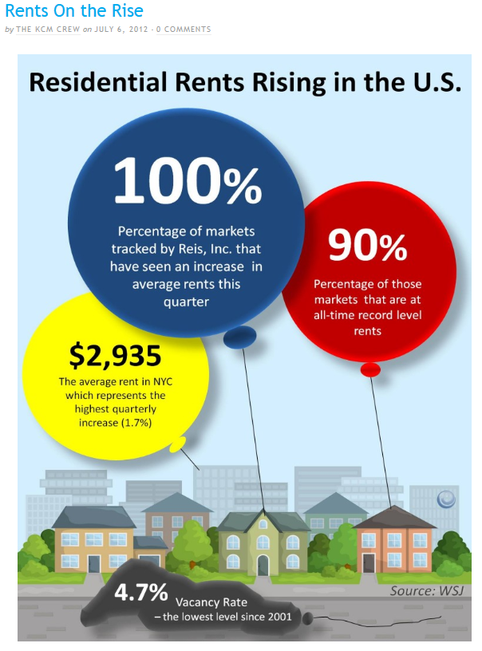
Area Principle
If your bar chart uses single graphics per bar
Area of a graph part SHOULD correspond to magnitude of value is represents

Slide 8
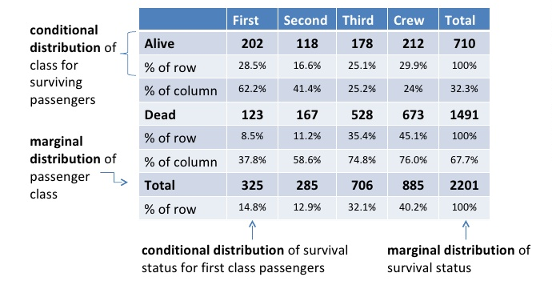
Contingency Table
Data is for two variables assumed to be contingent (aka contingent variables)
Is y contingent on x?
Conditional distribution; organized based on conditions
What is percent if x and y?
% of alive that are 1st class = 1st and alive/alive= 202/710
% of 1st class that are alive = _____________________________
Margins show frequency dist.s for each category (aka marginal distribution)
- Dist of classes = 14.8:12.9:32.1:40.2
Can write conditional dists for categories too
Dist of Alive:
___________________

Slide 9
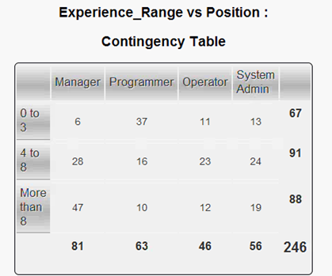
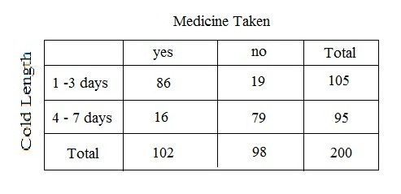
Thinking about H₀
“The best way to tell whether two variables are associated is to ask whether they are not.”
If dist. of one var. is same for all cat.s of another in contingency table, var.s are independent.
P(A|B) = P(A) → independence
Notes:
P(A|B) = P(A) P (cold 1-3 | Med taken ) = P (cold 1-3) (86/102) = 105/200 84.3% = 52.5%
P (cold 4-7 | Med not taken) = P (cold 4-7) 79/98 = 95/200 80.6% = 47.5%
P(man | 0-3) = P(man|4-8) = P(man|>8)=P(man) 6/67 = 28/91 = 47/88 9% = 31% = 53% nope
P(prog|0-3) = …P (prog) 37/67 = 16/91 = 10/88 nope
P(op | 0-3) = …P (op) 11/67 = 23/91 = 12/88 nope
P (sa|0-3) = …P(sa) 13/67 = 24/91 = 19/88 19.4 = 26.4 = 21.6 maybe
P(0-3|sa) = P(0-3) 13/56 = 67/246 23.2%=27.2%
P(4-8|sa) = P(4-8) 24/56 = 91/246 42.9% = 37%

Slide 10
Example 1: Gender and Eye Color
 | Blue | Brown | Other | Total
Males | 6 | 20 | 6 | 32
Females | 4 | 16 | 12 | 32
Total | 10 | 36 | 18 | 64
What percent of females are brown-eyed?
What percent of brown-eyed students are female?
What percent of students are brown-eyed females?
What’s the distribution of eye color?
What’s the conditional distribution of eye color for males?
Compare the percent who are female among the blue-eyed students to the percent of all students who are female.
Does it seem that eye color and gender are independent? Explain.

Slide 11
Example 1: Gender and Eye Color
 | Blue | Brown | Other | Total
Males | 6 | 20 | 6 | 32
Females | 4 | 16 | 12 | 32
Total | 10 | 36 | 18 | 64
What percent of females are brown-eyed? 50.0%
What percent of brown-eyed students are female? 44.4%
What percent of students are brown-eyed females? 25.0%
What’s the distribution of eye color? 15.6% blue, 56.3% brown, 28.1% other
What’s the conditional distribution of eye color for males?18.8% blue, 62.5% brown, 18.8% other
Compare the percent who are female among the blue-eyed students to the percent of all students who are female. 40% of blue-eyed students are female, while 50% of all students are female
Does it seem that eye color and gender are independent? Explain.
Since blue-eyed students appear less likely to be female, it seems that they may not be independent. (But the numbers are small.)

Slide 12
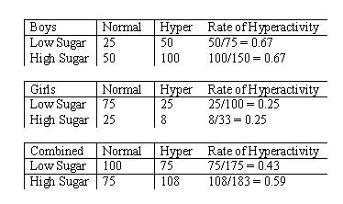
Is it appropriate? FACSS
Avoid “False Depth”
Category sizes/types should be equivalent
Y axis should range from zero to highest value
Area Principle
Categorical Data Condition
Sum to 100% (relative frequencies)
Avoid Simpson’s Paradox (“unfair averaging” for overall groups → diff. conclusion than comparing distinct groups)

Slide 13
What FACSS are violated?
Options:
False Depth
Area Principle
Categorical Data Condition
Sum to 100%
Simpson’s Paradox

Slide 14
What FACSS are violated?
 | Day | Night | Overall
Pilot Moe | 90 of 100 | 10 of 20 | 100 of 120
Pilot Jill | 19 of 20 | 75 of 100 | 94 of 120
Options:
False Depth
Area Principle
Categorical Data Condition
Sum to 100%
Simpson’s Paradox
 | Day | Night | Overall
Pilot Moe | 90% | 50% | 83%
Pilot Jill | 95% | 75% | 78%

