Slide 1
Chapter 26: Comparing Counts
(First of 2 Chapters in last (7th) unit)

Slide 2
Comparing for several counts?
For t and z –tests
We compared our observed mean OR proportion to single hypothesized values
We compared two means or two proportions
For t and z-intervals
We indicated the range at a specific % confidence for a single value
When we have several groups of data, need a new interval/test
Number of births per month (for all 12 months)
Number of jobs immediately upon graduation for different colleges

Slide 3
Chi-squared Goodness of Fit
Do several sets of data fit a null model?
Conditions
Counted Data: Each category has its own counted data (NOT proportions)
Independence of each data point
Randomization Condition
Each n<10% of population
Large enough n:
Expected Cell Frequency Condition: > 5 in each cell
*Caution: beware super large samples! With large enough n, X² test can always reject null hypothesis

Slide 4
Chi-squared Statistic
Hey – that’s a residual! (Obs – Exp)
Dividing by expected gives us a relative size to each difference.
Also use df = number of categories -1 ← !
Bigger chi-squared, bigger difference between observed values and expected values. How big is big enough? Use your table!
Note: chi-squared is a one-sided test (not for intervals)

Slide 5
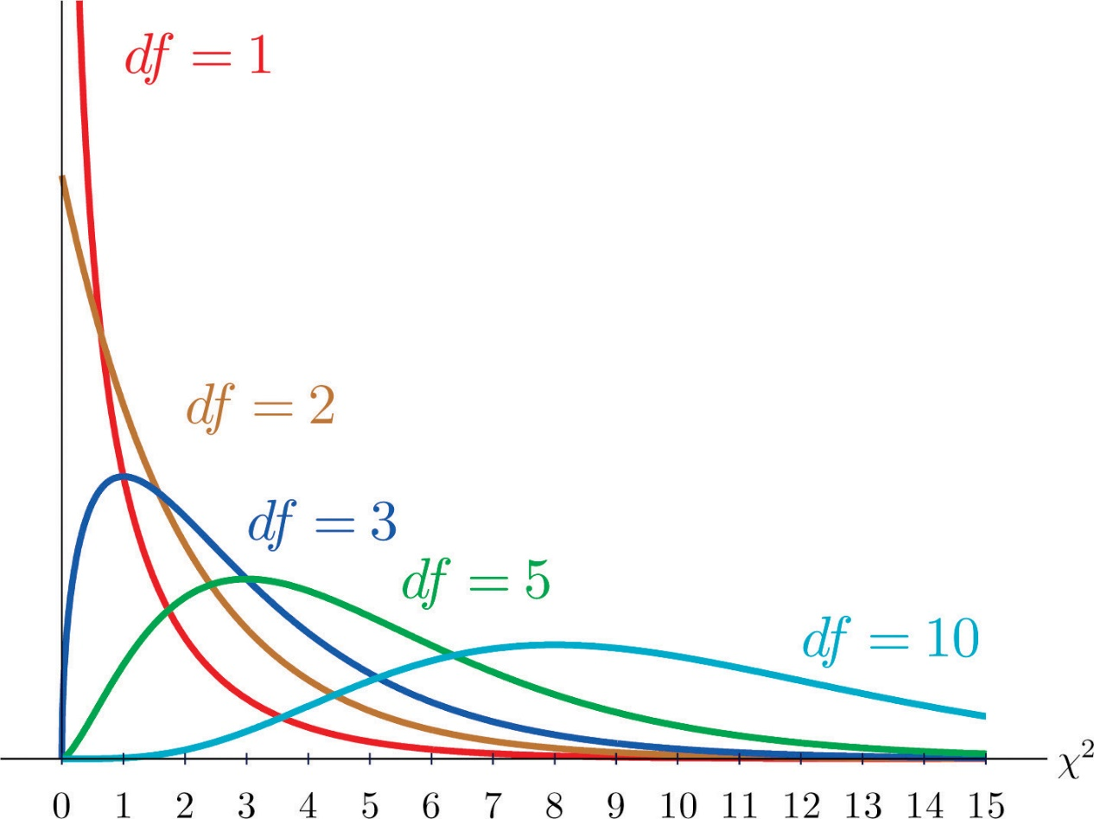
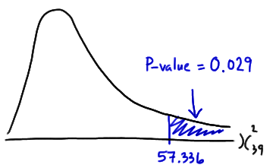
Note: a chi-squared distribution doesn’t even try to be normal. ☺ They are always skewed to the high end, and the p-value always considers the right tail.
For 4 categories of data and n=10 for each, X² is found to be 5.5. What is the approximate p-value and df?
What does the X² value for the set above have to be more than for us to reject the null model at probability less than 0.05?

Slide 6
Chi-squared Goodness of Fit example
Do it by hand first, then use table to find p.
TI:
STATS TESTS D: X2 GOF-Test indicate lists of counts, df
OR
DISTR X2 CDF (left bound (X2 value), right bound (e.g. 999), df)
 | Number born | Expected # born
Winter | 15 | 25
Spring | 35 | 25
Summer | 20 | 25
Fall | 30 | 25
 | 100 | 100

Slide 7
Chi-squared Test for Homogeneity
Comparing 2 groups – are their several sets of results the same?
Can compare a set of expected values (per an assumed proportion*, for instance or a theory, like from Mendelian Genetics)
Same conditions as X2-Goodness-of-Fit
*= Be sure Counted Data Condition is met!
df = (Rows-1)(Columns-1)

Slide 8
Further analysis: Standardize Each Cell’s Residual
Gives of a sense of direction of error
Observed more cases (+) or less cases (-)
Patterns by row or column?
For |large| ones, where on a Normal model do they show? 68-95-99.7 Rule?

Slide 9
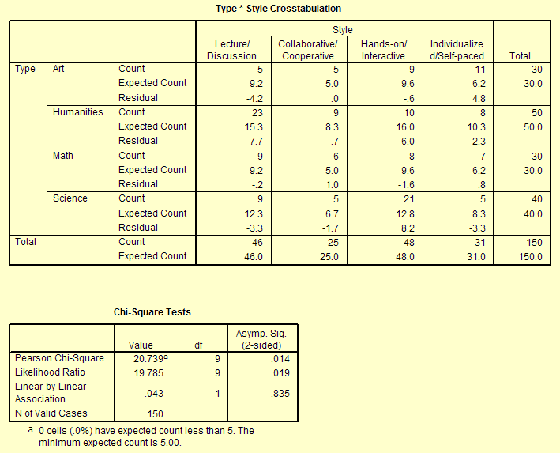
On any day, a class’ focus fell into one of 4 Style categories. Null hypothesis is that all Types of classes are taught with the same Style frequency.
If Chi-squared Test for homogeneity is used, why are expected counts different?
Collab art =5
Collab Humanities = 8.3
Is Expected Cell Frequency Condition met?
How was df calculated?
What is X²? What does this mean?
Observations about standardized residuals? (Why are std res better for conclusions than regular resids?)
STD RES. | Lecture/Disc | Collab/Coop | Hands-on/Int | Indiv/Self-P
Art | -1.385 | 0.000 | -0.194 | 1.928
Hum | 1.969 | 0.243 | -1.500 | -0.717
Math | -0.066 | 0.447 | -0.516 | 0.321
Science | -0.941 | -0.657 | 2.292 | -1.145

Slide 10
Chi-squared Test for Independence
Similar to test for homogeneity, but a different question:
Are the variables independent?
Are variables dependent? * Note that dependence is not proven directly, but we can check for (and reject or fail to reject) independence.
Same conditions!
Also check residuals when you are done → great for adding detail for conclusion.

Slide 11
Chi-squared Test for Independence Example
Is frequency of dining out in a month dependent on monthly income?
Calculate expected values, then X2, df, p-value, std. resid.s. Write conclusion
 | Eat out | Eat at home | TOTAL
income<$1K/month | Obs: 106 Exp: Std Res: | Obs: 146 Exp: Std res: | 252
$1K<income<$2K/month | Obs: 105 Exp: Std res: | Obs: 315 Exp: Std res: | 420
income>$2K/month | Obs: 49 Exp: Std res: | Obs: 119 Exp: Std res: | 168
TOTAL | 260 | 580 | 840

Slide 12
Goodness of Fit, Homogeneity, or Test for Independence
Goodness of Fit: sets vs. model
Homogeneity: sets vs. sets “are the groups homogenous?”
Independence: sets vs. sets “are variables independent?”
Number strawberries rotting after 1 week with gamma radiation special spray, nothing.
Number of 7^{th,} 8th, 9th, 10th graders interested in a tech career compared to national average.
Is number of friends dependent on where one lives (dorm, sorority, off-campus apartment)?

Slide 13
X² with a table on the TI (for indep & homogeneity)
Enter Observed Values:
MATRIX
EDIT [A]
Indicate rows x columns (give numbers for size)
Enter counts, cell by cell (calculator gets them one row at a time)
Run test and calc expected values:
STAT TESTS C: X2-TEST
Confirms using [A] for observed values.
Tells you expected values will be put in [B]
CALCULATE
Check [B]: MATRIX EDIT [B]
No automated calculation of standardized residuals! CB wants to see work, so calculator should only be used to check work/for MC.

