Slide 1
Chapter 10
Re-expressing Data (to Straighten Linear Regressions)
AP Statistics

Slide 2
I wanna use r… but assoc is not linear!
Straighten to SIMPLIFY the model and SIMPLIFY explanation of it.
Occam’s Razor: Simpler explanations are likely better explanations
Linear association allows us more precision!
r
R²
Linear equation
Yes, there is a Curve of Best Fit, but stat.s is limited for this, so we won’t use it!

Slide 3
Common Problems and Solutions
Lack of symmetry due to skew → log
Spread of compared groups not the same → log
Association not linear → log
Spread in scatterplot fanned → log
What’s a common solution?

Slide 4
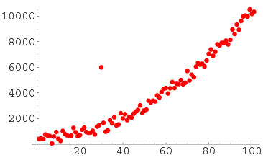
What I cannot “fix” with transformation:

Slide 5
Ladder of Powers (btwn 2 and -2)
Power | Transformation | When to use
2 | y² | Distrib. is unimodal with skew to left
1 | No change
½ | y^{½} = sqrt(y) | Counted data.
0 | log (not y⁰) | Values that increase by %s.
- ½ | y ^{-½} = -1 / sqrt(y)
- 1 | y ⁻¹ = - 1 / y | Ratios (e.g. mph)
Start at power 1. Move up or down ONE and evaluate. Better? Keep moving in the same direction until you’ve found your ideal.
Tips:
If values have zeros, add a small constant before transforming with log or division by y.
Losing direction of data with transformation? Think about -1/2 and -1 power
Negative data? Careful! Some transformations (e.g. logs)→ losing info. Try adding a constant first.
ALL data far from zero? Subtract constant first (but not so much to make values zero).

Slide 6
Examples
Power | Transformation | When to use
2 | y² | Distrib. is unimodal with skew to left
1 | No change
½ | y^{½} = sqrt(y) | Counted data.
0 | log (not y⁰) | Values that increase by %s.
- ½ | y ^{-½} = -1 / sqrt(y)
- 1 | y ⁻¹ = - 1 / y | Ratios (e.g. mph)
What transformation, if any?
Number of birds counted and temperature (degrees C): scatterplot shows upwardly curving pattern.
Price in Paris and Price in Hong Kong: Scatterplot shows a straight pattern with a small amount of scatter.
Population growth of US over past 200 years: Scatterplot shows a strongly upwardly curved pattern.

Slide 7
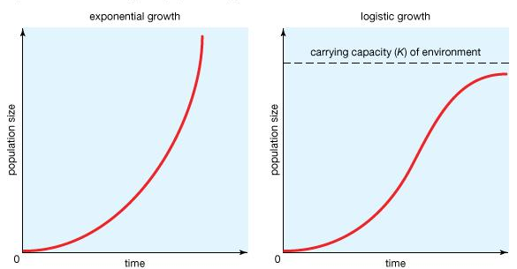
Curvature stubborn? Not happy with residual plots?
Try in this order (x variant stays on x axis):
log(x) vs. y ← Logarithmic: wide range of x values, perhaps growth curve with leveling
x vs. log (y) ← Exponential: 0 on Ladder of Powers
log (x) vs. log (y) ← Power: when one power on Ladder of Powers to big and next too small, this may be just right (“Goldilocks Model”)
HEY! No data can be zero or negative!

