Slide 1
Ch 13: Observational Studies & Experiments
AP Stats (last chapter of Unit 3)

Slide 2
Study Types
Survey
Observational – researchers observe data
Retrospective – using prior data in a new study
Prospective – collecting data as it occurs
X vs y but researchers don’t change x, and can only measure y
Experiment = x vs y w researchers actively changing x

Slide 3
Experiment
Remember we should have a 2nd random too: Random Sampling!
Goal: prove a causal relationship
Requires:
Active & deliberate manipulation of factor levels to create treatments
Random assignment of subjects to treatments
Comparing responses of subject groups across treatment levels
Explanatory variable = x = factor
Response variable = y = what is measured
Subjects = participants = experimental units
Levels = specific values used for factor
Treatment = combo of levels that participant receives

Slide 4
Completely Randomized Experiment
 |  | Were indiv.s randomly assigned to treatments?
 |  | Y | N
Were indiv.s randomly selected to be in study? | Y | CAN Infer about pop CAN Infer about cause and effect | CAN Infer about pop
 | N | CAN Infer about cause and effect | (Can’t infer anything)

Slide 5
Block or Match?
In an experiment, we don’t use the term “Strata.” We use “Block” instead.
A block is NEVER a treatment.
Example of a block variable/state?
Match: Sometimes we want to block, but we don’t have big enough numbers per block (recall we need well over 30 so we can get n=30 for each block once we randomly sample)
Match = alternative. We force A1 to be in one treatment, and A2 in the other, so we have representation for a would-be block in each treatment and can see what the treatment does.
Popular matching when each block is tiny: You Before vs. You After

Slide 6
Example with vocab!
Explanatory variable = x = factor
Response variable = y = what is measured
Subjects = participants = experimental units
Levels = specific values used for factor
Treatment = combo of levels that participant receives (includes controls)
Studying impact of blue light on speed to respond to a visual stimuli. 132 ten-year-old children are randomly assigned to four groups: one with exposure to white light (with standard 1x blue), one with exposure to 1x blue light, one with exposure to 3x blue light, and one with exposure to white light without blue. All are told they will be measured for their speed to accurately “whack a mole” appearing on a digital screen.

Slide 7
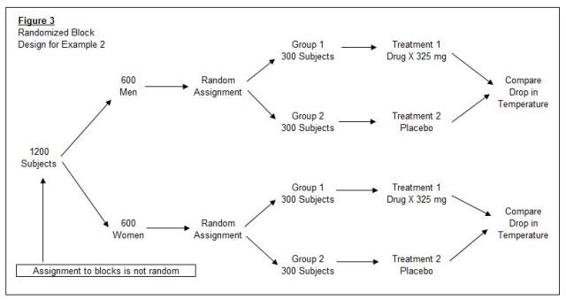
Explanatory, response variables? Subjects, levels, treatments?
Blocks were used: Blocking variables = variables that we think will impact results (~strata in surveys.)

Slide 8
4 Principles of Experimental Design
Control sources of variation from variables other than the ones we are testing, by making test conditions similar
Randomize
Is randomization clear in the procedure? (see diagram below)
Replicate both experiment and experimental units (subjects)
n = 1 ← anecdote
Is procedure clear / diagrammed so it can be replicated reliably?
Are results reliable across subsets of population assumed to be the representative?
Block or Match (as required)
Group similar (by blocking variable) individuals together, then randomize w/in blocks to reduce variability w/in group (makes impact of factor more apparent): Randomized Block Design
Matching: subjects similar in ways not under study are placed each in one group (to be compared later) → reduces variability btwn gps
Match when not enough influential subjects to make own group
* Note: we don’t stratify an experiment or block a survey sample.

Slide 9
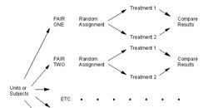
Matching: this diagram shows process of assigning variants to groups)

Slide 10
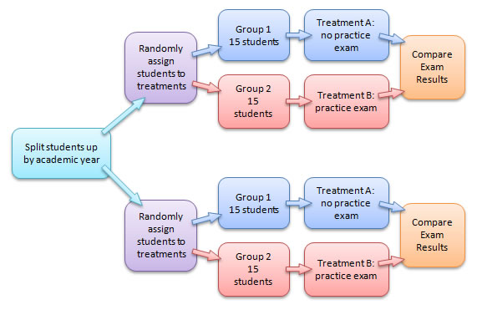
H: Exposing students to a practice exam will result in different exam scores that are statistically significant. Block 1 = students with As, Block 2 = students with Bs. I will replicate this experiment 2 times, so total n is 120. I will compare exam results within each block and across blocks, using box and whisker plots. (A detailed procedure is missing here.)

Slide 11
Is the Difference Statistically Significant?
How big is “big enough”?
Is the difference the same as what we would get from randomization alone? No. Then the difference is NOT statistically significant.
Is the difference bigger* than what we get from randomization alone? Yes. Then the difference is statistically significant.
* We’ll make this more precise later.

Slide 12
Blinding
Blinding – avoiding bias by disguising attributes
For ones who could influence results – subjects, treatment admin., technicians OR ones who evaluate results – judges, treating physicians, research PI (single blind)
Both classes (replace OR with AND above) (double blind)
Placebo: has same attributes as pill except for active ingredient
Placebo effect: did “thought” of treatment → data?
Blinding by misleading – experimenter tells subjects they are being tested on something else so as to blind them to the subject of the study (Hawthorne Effect: when knowing what is studied impacts results)

