Slide 1
Chapter 27: Inferences for Regression
Final chapter!

Slide 2
Inference from a correlation?
Discuss with your table groups. All still VERY relevant!
Scatterplot → association → (sometimes) correlation with R-squared
Caution: outliers, high-influence points
Caution: extrapolation
Caution: correlation and causality
We can find slope using standard deviations and R (how?)
We can find y-intercept using means and slope (how?)
The scatterplot and corresponding linear equation is based on a sample set. We can infer from this…

Slide 3
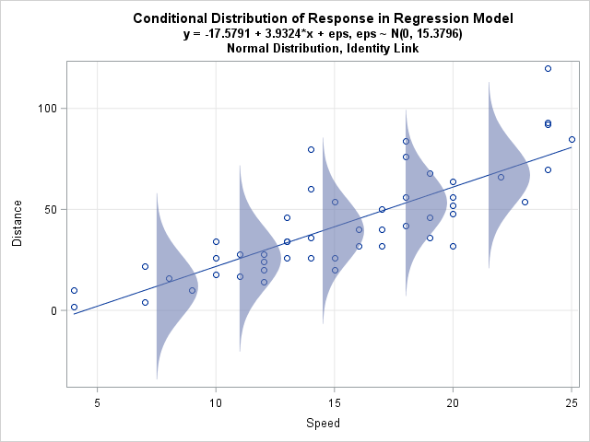
Inferring for a pop from a regression of a sample assumes… for pop
Means of y for each x fall along line
Values of y for each x create a normal
distribution (pictured vertically)
Our line based on a sample:
y-hat = b₀ + b₁x
Our inferred line (for pop):
µ_{y} = β₀ + β₁x for our line
note greek symbols as this is a model for pop (parameters)
Ɛ = y - µ_{y} error (residual) is observed – expected for each (x,y)
y = β₀ + β₁x + Ɛ for solving for each y, considering error

Slide 4
Condition Checking
Straight Enough Condition: Is association a correlation?
Look at scatterplot of residuals against x or y-hat (plots should be h_______ or have no pattern)
Randomization Condition
<10% population
“Does the Plot Thicken? Condition” / Equal Variance Assumption
Look at size of scatter (std dev of residuals, s_{e})
Same scatter everywhere?
BAD: Fans. Gaps.
Nearly Normal Residuals Condition (distrib of residuals needs to be normal or n great)
Plot histo of residuals → normal?

Slide 5
Residual standard deviation
s_{e}
Measures spread about the line
Y_{est} = y-hat in this formula for s_{e} (or s_{res}):
n-2 is used as we don’t truly know slope and intercept; modify our degrees of freedom
s_{e} and R-squared tell us about strength of regression

Slide 6
Strength of model, inference?
Higher n…
Higher variance of x (thus s_{x})…
Lower residuals (thus spread about the line, s_{e})…
All lead to more consistent inference of slope
(and its std error, SE(b₁))

Slide 7
Lin Regression T-test
Could also make a distrib for intercepts, but usually don’t find this as interesting.

Slide 8
Regression Inference
With the t-model
t-interval STAT TESTS LinRegTInt
t-test Note: software usually assumes 2-sided only!
Remember df = n-2
Null hypothesis: slope is zero (y and x don’t have a linear relationship)
STAT TESTS LinRegTTest give lists, Freq:1 (each point counts once)
tell it to store equation as Y1 (remember?)
returns t, p, coefficients of regression: a and b, s (std dev of errors around the true line), r-squared, r… DOES NOT give SE(b)
t=b-0/SE(b)

Slide 9
Example
Does temperature influence time to complete a marathon? (SRS for 11 marathons)
Check association first
Name of test
Hypothesis
Conditions
Calculate SE, test statistic, draw model, show work
State a conclusion
Degrees F | Minutes to run marathon
44 | 142.7
46 | 142.1
47 | 143.4
50 | 143.6
51 | 144.0
52 | 143.4
54 | 142.4
55 | 143.1
57 | 143.7
60 | 143.4
65 | 143.4

Slide 10
Group practice: Problems 1, 2 (Chapter 27)
Be ready to discuss!

