Slide 1
Chapter 8 & 9
Linear Regression (with wisdom!)
AP Statistics

Slide 2
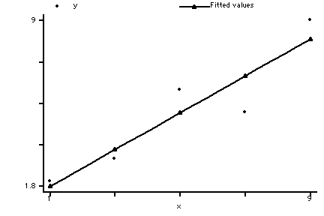
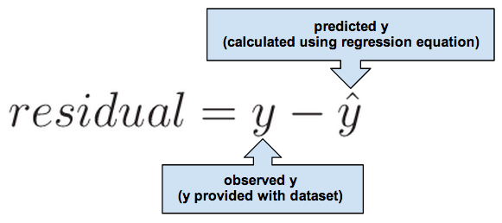
Linear Model
Linear Model = Line of Best Fit = Regression Line
Given x, predict y : “y hat”
will be on line
How far is data from line?

Slide 3
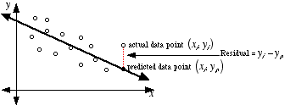
Interpreting residuals
residual = e “error between data and model”
-e : is an overestimate
+e : is an underestimate
Smallest sum of squares of e gives us “line of best fit” (your software does this for you)

Slide 4
Correlation Coefficient = “index of correlation” = r
If data standardized, line:
ẑ_{y} = r zx ← standardized means intercept is zero…
r = slope of standardized line
“moving any # of std. dev. in x, moves r times that # of std. dev.s in y”
Ex.: For regression comparing burger fat and protein content: ẑ_{fat} = 0.83 z_{protein}
“ given protein content, ____ content is _____ std. dev.s above or below the mean ___ content”
Notes:
Always add units when describing slope. Even for standardized lines, can add context (e.g. fat and protein)

Slide 5
r = 0 for ẑ_{y} = r z_{x}?
What if r=0? Discuss at your tables.
REMEMBER:
If data standardized, line:
ẑ_{y} = r z_{x}
r = slope of line
“moving any # of std. dev. in x moves r times that # of std. dev.s in y”
Notes:
No linear relationship, line is horizontal. X doesn’t predict y.

Slide 6
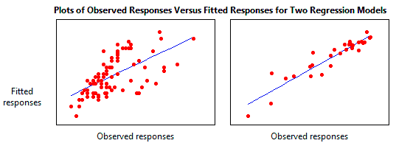
r² (aka R² )
r² = % of variability in y explained by x
r² = variation accounted for by linear model
1- r² = fraction of original variation left in residuals
r² is between ____ and ____
Remember, r isn’t a %... But r² is! ☺

Slide 7
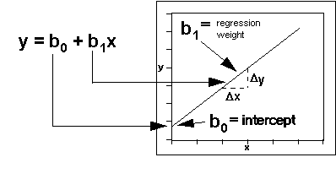
Non-standardized regressions
Recall: y = mx + b… but we’re in statistics
b₀ = ӯ – b₁
b₁ = (r s_{y})/s_{x}
What stats does your calculator report for LinReg?
Want to see line on your scatterplot?
LinReg (a + bx) L1, L2, Y1 ←VARS, Y-VARS, 1:Fxn, Y1
GRAPH: line printed on existing scatterplot

Slide 8
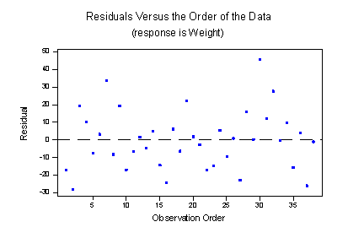
x vs. residuals: Check for Linearity
Linear Regression must be Linear = “Straight enough condition”
x vs. residuals → see neither direction, shape, nor outliers
Standard deviation of residuals:
S_{e} = √((Σe²)/ (n-2))
Note: * Don’t subtract ē, as ē = 0,
* subtract 2 (not 1) as we estimate 2 parameters (slope, y-int)

Slide 9
Residual Plot on TI
Calculator creates list of residuals as you regress. Use it!
STAT EDIT
find RESID (it’s there! No? In first blank list, import RESID in LIST NAMES menu)
Set up a scatterplot: X: (same x used before), Y: RESID
Visit Y= to turn off the old plot, and turn on this new plot (else they will be superimposed)
Try it with the sample set today. ☺

Slide 10
Cautions…
Regression for y from x ≠ regression for x from y
Can’t use x predictor (on y) to predict z
Perform a new regression for z on y!
Don’t extrapolate: don’t predict for x beyond range of x in model
Use predictions to check regression equations. Do predictions seem reasonable?
Regression ≠ causation
R² accounts for variation in data, not data itself
Outlier = datum with large residual
Has high leverage, influence (remove and re-model)
Can hide in plots of residuals. Try a scatterplot of data first.
Be leery of regressions on summaries
Summaries remove data, scatter, outliers… can’t trust them on their own! Remember Simpson’s Paradox?

