Slide 1
Ch 7 Scatterplots, Association, and Correlation
AP Statistics
Beginning of Unit 2

Slide 2
Scatterplot
Relationship btwn 2 quant. var.s (LABEL!)
x: explanatory or predictor var.
y: response var.
Features:
Direction: +, -, or zero
Form: linear, curved, other?, no pattern
Strength: how much scatter?
Unusual features: subgroups? outliers?

Slide 3
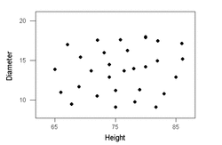
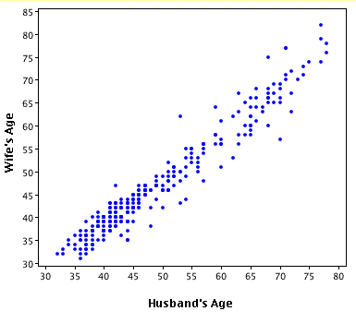
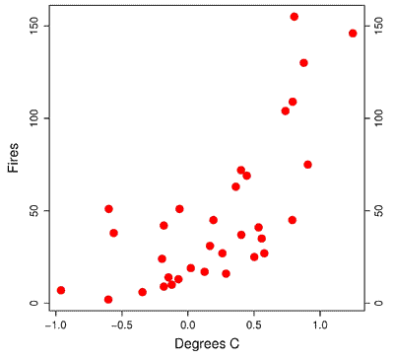
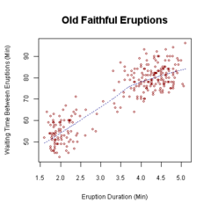
Scatterplot ex.s
Direction: +, -, or zero
Form: linear, curved, other?, no pattern
Strength: how much scatter?
Unusual features: subgroups? outliers?

Slide 4
Conclusion words…
Got scatterplot…
Association ☺
Add r… (more detail)
Correlation
Careful! Correlation IS NOT causation!
Beware LURKING VARIABLE
Variable that stands behind a relationship and determines it by affecting BOTH associated variables.
Outdoor people use more sunscreen.
Outdoor people get more skin cancer.
Sunscreen _________________ skin cancer.
A good study CONTROLS lurking variables so they are held constant
Notes:
We use CONTROLS in studies to control what might otherwise be a lurking variable.

Slide 5
Correlation
Strength of LINEAR association btwn 2 quant var.s (must meet Quant. Var. Cond.)
Standardize data first so:
Each point: (z_{x}, z_{y})
axes units and distance btwn. ticks is uniform
perception is not biased
Add all products of points: Σ(z_{x}z_{y})
Sum indicates strength of association but OF COURSE gets bigger with more data, so divide:
Correlation Coefficient = r
r has no units and is not a %
Product indicates direction of association (+, -, 0)
Another version:

Slide 6
Correlation Exs

Slide 7
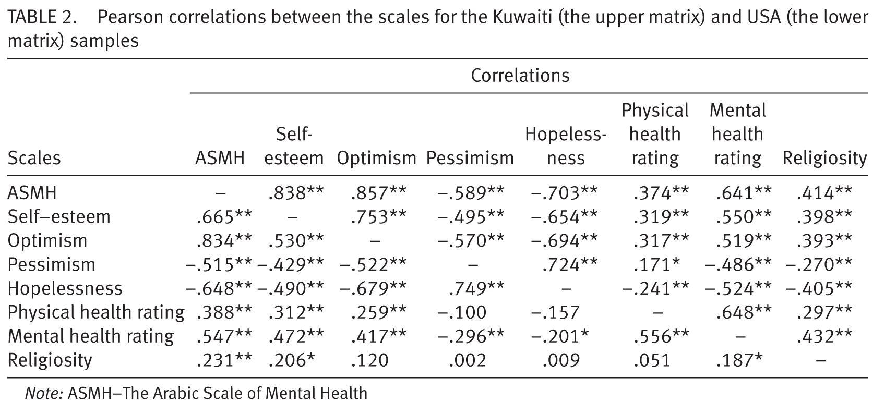
Correlation Tables
Avoid using in isolation!
Show with a scatterplot
Allow user to check for linearity, outliers

Slide 8
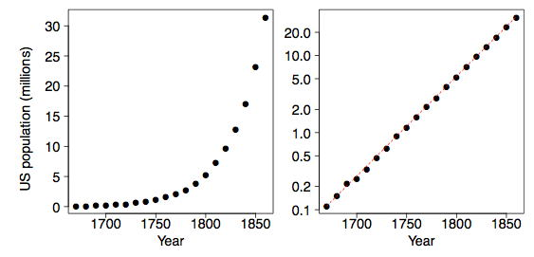
Straightening Scatterplots
See a curve? DON’T CALL IT CORRELATION
DON’T USE R, R², LINEAR EQUATION!
Later we’ll: Transform it to make it linear.
Try log, square, square root…
Now can correlate!
Notes:
Log used to transform

Slide 9
LinReg on TI-83 or 84
Enter Ch 7 #20 example data (Burger) as 2 lists
Statplot → Scatterplot
Zoomstat → get a decent window
Describe your scatterplot
Repeat comparing calories (list 3) to Fat
Does it matter what is x in either comparison?
Calc → LinReg
What is r?
What is the regression line’s equation? Can it be described WITHOUT the scatterplot?
Notes:
Catalog: Diagnostic needs to be “on”

Slide 10
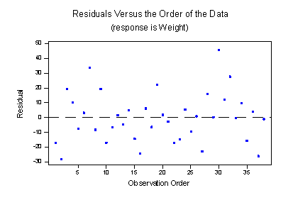
x vs. residuals: Check for Linearity (Ch 8)
Linear Regression must be Linear = “Straight enough condition”
x vs. residuals → see neither direction, shape, nor outliers
Standard deviation of residuals:
S_{e} = √((Σe²)/ (n-2))
Note: * Don’t subtract ē, as ē = 0,
* subtract 2 (not 1) as we estimate 2 parameters (slope, y-int)

Slide 11
Residual Plot on TI
Calculator creates list of residuals as you regress. Use it!
STAT EDIT
find RESID (it’s there! No? In first blank list, import RESID in LIST NAMES menu)
Set up a scatterplot: X: (same x used before), Y: RESID
Visit Y= to turn off the old plot, and turn on this new plot (else they will be superimposed)
Try it with the sample set today. ☺

Slide 12
More Regression & Correlation Practice
At table groups, have each person use a different data set to:
Find the correlation coefficient (be ready to say NO*)
Find the regression least-squares line (say NO?*)
Use the line to predict y for x = 10 (say NO?* or Extrapolation?)
Make a scatterplot, add line to it (use Y= on TI)
Make a residual plot – note what you see that helps you decide something above
Describe what you see – form, direction, strength
* Let’s practice putting our foot down! BE DRAMATIC!
Put your work into the Google Slide on the Weebly site.
Notes:
Note group D: Clusters/outliers, another group is non-linear, so no business using r… would want to square data or similar transformation (end of Ch 7 shows how calc entry is just L1^2 → L3 or similar) to generate linearity before attempting to use r.

