Slide 1
Ch 4: Quantitative Displays
AP Statistics

Slide 2
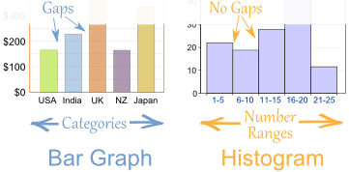
Histogram
Displays frequ. or relative frequ. of #s in bins
Quantitative Data Condition = use quant. data w units
No space between bars – quantitative values and bins are continuous
Make sure each bar has equal width
(not doing so = violating A_____ P___________)
Note the difference between a histogram and bar chart

Slide 3
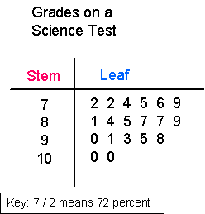
Stem and Leaf Display
Quantitative Data Condition
Be sure all characters take up equal amounts of space, lining up
Better than histogram; can see data
Displays frequency distribution like histo.
Works best for small sets

Slide 4
Dotplot
Meets Quant. Data Condition
Like Stem and Leaf, but:
dot replaces #
Great for looking at clusters
What are clusters?
In the second case, it’s not a second cluster but an ______________.

Slide 5
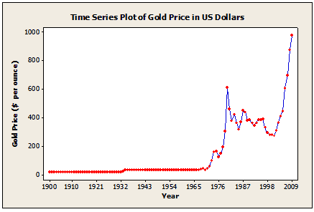
Timeplot
x: time
y: Quant. variable ← so meets what condition?
Connect data points with a line

Slide 6
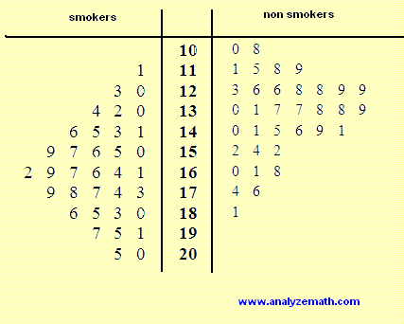
Shape, Center, Spread
All quantitative displays have these – use vocab to describe and compare what you see. Think about meaning.
For comparisons – use the same scale!
(graphs don’t need to touch)

Slide 7
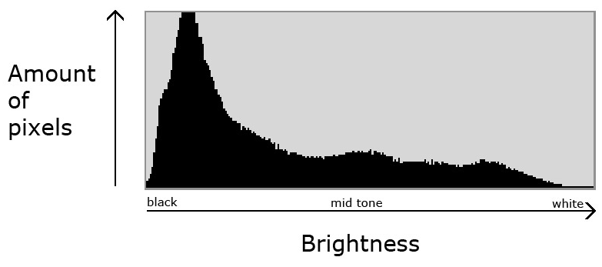
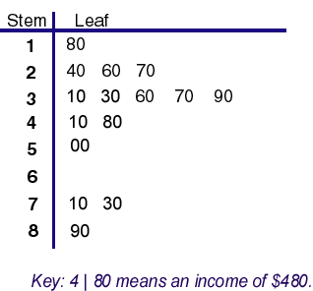
Shape
Unimodal, bimodal, multimodal, no mode = uniform distribution
Symmetric? Tail length same, skew to side of longer tail
Outliers? Never just throw away; could be most significant piece of data (and reliable), error. Analyze w/ and w/o.
Gaps? What if data is separated and reanalyzed?
Why did we not analyze shape of bar charts? (Hint: find one in your notes)

Slide 8
Re-expressing or Transforming Data
Goal: make skewed distribution more symmetric
Apply a simple fxn (e.g. exponential fxn)
Skew to right? Try logs or square roots
Skew to left? Try squaring

Slide 9
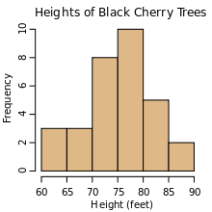
Center
Single number to describe data
(refer to Ch 5)

Slide 10
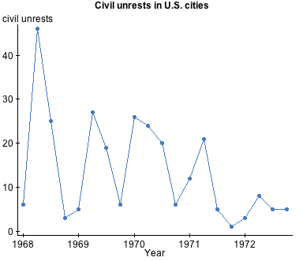
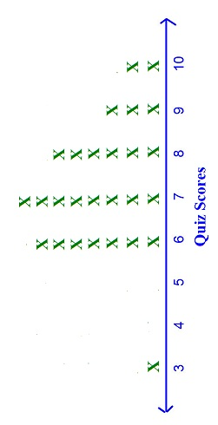
Spread
Variation

Slide 11
Issues: FAQS
Categorical (bar chart, pie chart) displays
F
A
C
S
S
Changes for quantitative displays?
Replace C with Q
S (one)
Notes:
\\mvhsfs4\Math\Media\Against All Odds-inside Statistics

