Slide 1
Ch 12: Sample Surveys
AP Statistics (Unit 3)

Slide 2
Poll vs. Census
Poll = sample survey
Select individuals at random.
On average, sample should look like pop.
sample is representative of pop (no parts OVER or UNDER represented)
n = big enough to measure full range of data (n is not defined by a % of pop)
Census = survey of entire pop
Why does this never/rarely happen?
Hint: Consider a census for saltiness of soup.
Notes:
Census not likely cuz (1) difficult to test everyone. Do you really want to taste ALL twinkies?
(2) Pops constantly change; (3) Too complex (might end of counting a person more than once)

Slide 3
Poll Design Example
Ex: Testing Twinkies for freshness (absence of mold).
Design your poll!
Component:
Trial:
Response Variable:

Slide 4
Simulations and Surveys give us Models
Population Model has parameters (not statistics)
Estimated by sample statistics
Sample statistic = summary calculated from data
We use greek symbols for estimates – “unknowable.”
We use roman symbols for what we actually measure.
When stats. reflect parameters accurately, sample = representative
Pop. parameter | Sample statistic
μ “mew” | ȳ “y-bar” (mean)
σ “sigma” | s “s” (std. dev)
⍴ “rho” | r “r” (correlation)
β₁ “beta-one” | b₁ “b-one” (slope)
p “pee” | p̂ “p-hat” (proportion)

Slide 5
What is incorrect about these claims about surveys?
It is always better to take a census than to draw a sample.
Stopping students on their way out of the cafeteria is a good way to sample if we want to know about the quality of the food there.
The true percentage of all Statistics students who enjoy the homework is called a “population statistic.”
Try these too (haven’t lectured about this yet):
We drew a sample of 100 from the 3000 students in a school. To get the same level of precision for a town of 30,000 residents, we’ll need a sample of 1000.
A poll taken at our favorite Web site (www.statsisfun.org) garnered 12,357 responses. The majority said they enjoy doing statistics homework. With a sample size that large, we can be pretty sure that most Statistics studens feel this way, too.

Slide 6
Sampling Types
Simple Random Sampling
Stratified Random Sampling
Cluster Sampling
Multistage Sampling
Systematic Sampling
Voluntary Sampling ☹
Convenience Sampling ☹
Notes:
Write these terms down – you’ll need to distinguish between them by the time we are done!

Slide 7
Simple Random Sample
SRS
Each sample has equal chance* of being selected
Each combo of samples has equal chance of being selected
Standard to compare other sampling methods to
* How do we do that?

Slide 8
Sampling Frame
List of indiv.s from which sample is drawn
Defines total pop.
Sampling Frame
+ → SRS
Random # Generator

Slide 9
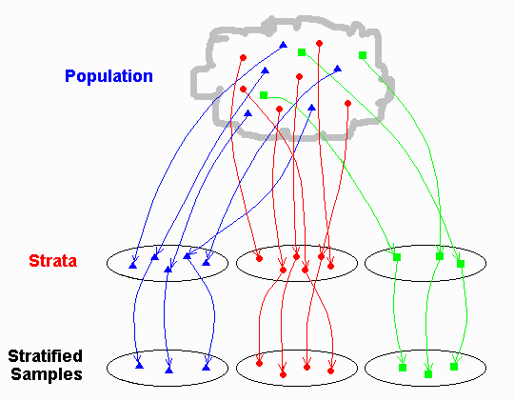
Strata in Pops
Heterogenous population: female, male, rich, poor, middle class, babies, teens, adults…
Assumptions:
Strata differ from each other, but within strata, homogenous
Each strata NOT representative of whole pop.
Sampling strata reduces variability between in-strata samples. Can then compare different strata (avoid Simpson’s Paradox ).
If we divide into strata and sample strata, this is Stratified Random Sampling
Ex: Assessing employment rate. Female, male = strata
Ex: Surveying about a G cartoon movie. Strata = ?

Slide 10
Clusters in pops
Cluster = similar part of pop
Assumption: one cluster is similar to another cluster. Each cluster heterogenous and representative of whole pop.
Census entire cluster =
Cluster Sampling
Ex: Assessing a sentence in a book. Page = cluster.
Ex: Assessing MVHS Students about stress. Cluster = ?

Slide 11
Cluster, Strata, and SRS
Common:
Sampling Frame: All clusters, each in different strata
+
Random number generator to pick some clusters
SRS
Note: Multistage Sampling = Sampling scheme combining several methods.

Slide 12
Systematic Sampling
From random starting point
with Sampling Frame
randomized
pick every 10th piece of data
Last part = Systematic Rule
MUST justify that Syst. Rule isn’t associated with any of measured variables.

Slide 13
Danger! Voluntary Response Sample
Danger! Voluntary Response Bias
Almost always biased → conclusions drawn from them almost always wrong
People with – opinion tend to respond more than people with + opinions
Biased towards those w strong opinions or those who are strongly motivated

Slide 14
Danger! Convenience Sampling
No well defined sampling frame
E.g. Internet survey at website regarding computer use
E.g. Grocery store survey re. purchase practices
Neither are representative of the entire pop!

Slide 15
Danger! Undercoverage
Some proportion of population is not sampled at all or is under represented
Why most survey results include details about the survey respondents and details about the whole pop.

Slide 16
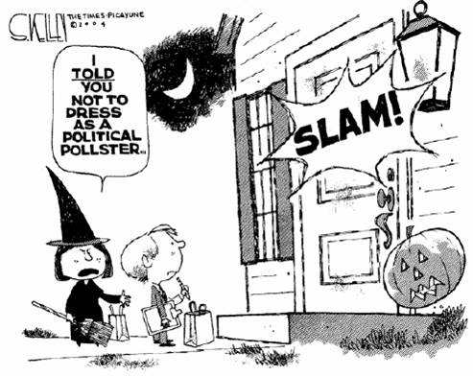
Danger! Nonresponse & Influential Response Bias
Common and Serious Source of Bias
Issue if those not responding differ from those that do
Avoid survey refusal by:
Keeping survey short
Only ask ?s whose answers would direct you to model or do differently
Avoid influential responses
Response Bias = anything in survey design that influences responses
Don’t ask personal facts
Don’t ask about illegal behavior
Remove desire to please interviewer
Avoid leading statements
Avoid misinterpretation or confusion

Slide 17
Recovery from bias?
No way to recover from bias!
Statisticians know this!
Always report your sampling methods in detail

Slide 18
Sampling Types
Simple Random Sampling
Stratified Random Sampling
Cluster Sampling
Multistage Sampling
Systematic Sampling
Voluntary Sampling ☹
Convenience Sampling ☹
Notes:
Write these terms down – you’ll need to distinguish between them by the time we are done!

Slide 19
Practice
Each group will do one problem, then we’ll share out. For all, ID:
Population
Pop parameter of interest
The sampling frame
The sample
The sampling method, including whether or not randomization was employed
Any potential sources of bias and any problems you see in generalizing to the population of interest
Ch 12 (3, 5, 6, 9, 10, 14, 15, 32a, 32b)
Let’s look at a thorough example on the next slide.

Slide 20
Example: #2
A question posted on the Lycos Website on 18 June 2000 asked visitors to the site to say whether they thought that marijuana should be legally available for medicinal purposes.
Pop = All people
Pop parameter = proportion of people thinking med marijuana should be legal
Sampling Frame = list of IPs visiting site (?)
Sample = people who volunteer to do survey
Method = Convenience (who came to site) & Voluntary Sampling. No randomization was employed.
Sources of bias = Nonresponse bias, Voluntary Response Bias (negative or more vocal opinions tend to predominate), asking about illegal activity, Convenience Sampling Bias (overrepresentation (just “wealthy” with a Internet-enabled digital device and free time)/underrepresentation), overrepresentation because users can be counted more than once (if new IP) or underrep if same IPs-different users cannot be counted (for family using same IP).

