Slide 1
APCSP Meeting
March 23 Week

Slide 2
Getting Started with Zoom
BEFORE CONNECTING
Setup a Quiet Place
Dress appropriately
Check your Audio and Video settings before joining. Are you on mute? Is your camera on? You can adjust both of these settings in the bottom left corner “mute” and “video” icons in Zoom.
Pick a good background: you don’t want objects or other people in the video. Put your back against a wall or use a virtual background and Ensure your Profile picture is appropriate.
DURING THE CONFERENCE
Follow teacher guidelines: If you aren’t sure, ask your teacher (Chat or Interrupt kindly).
Keep conversation appropriate - share topics relevant to class and your well-being as a student.
Monitor your Audio and Video settings. Are you on mute? Is your camera on? You can adjust both of these settings in the bottom left corner “mute” and “video” icons in Zoom.
Participate when prompted: Chat, video gestures (e.g. thumbs up), and/or audio.
Breakout Rooms may be used during small-group discussion.

Slide 3
Deep breaths… and gratitude!
Three things to be grateful for. (Write them down on your paper.)

Slide 4
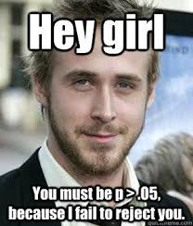

Slide 5
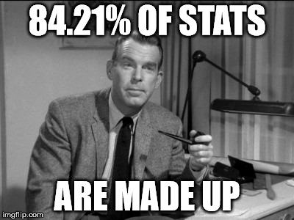

Slide 6
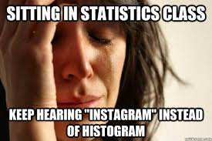

Slide 7
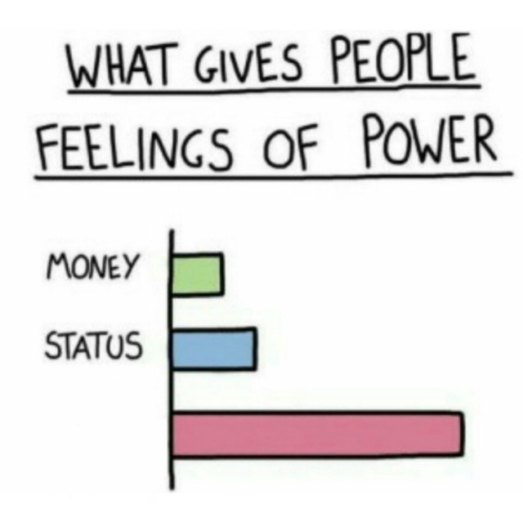

Slide 8
Agenda
College Board Changes
HW Changes
Review #1

Slide 9
College Board Changes
Exam offered on 2 diff dates, can be done from home and open note
Chi-Squared and Linear Regression Inference not required (Chapters 26, 27)
Exam shorter
More detail to come in next 2 weeks!

Slide 10
HW Changes
Unsafe to receive paper HW
Tedious to grade multiple photos from each student
OLD HW can be emailed (photos)
NEW HW will be online with answers submitted through tools (Khan, AP Classroom a la College Board)
Less than 80%? No/Low Credit. Redo if this happens for no penalty. Mrs. F will make retake versions of AP Classroom assessments. Khan can be redone and hints can be harvested immediately if you need them.
HW will be on schedule for week – see Weebly site.

